Slide 1
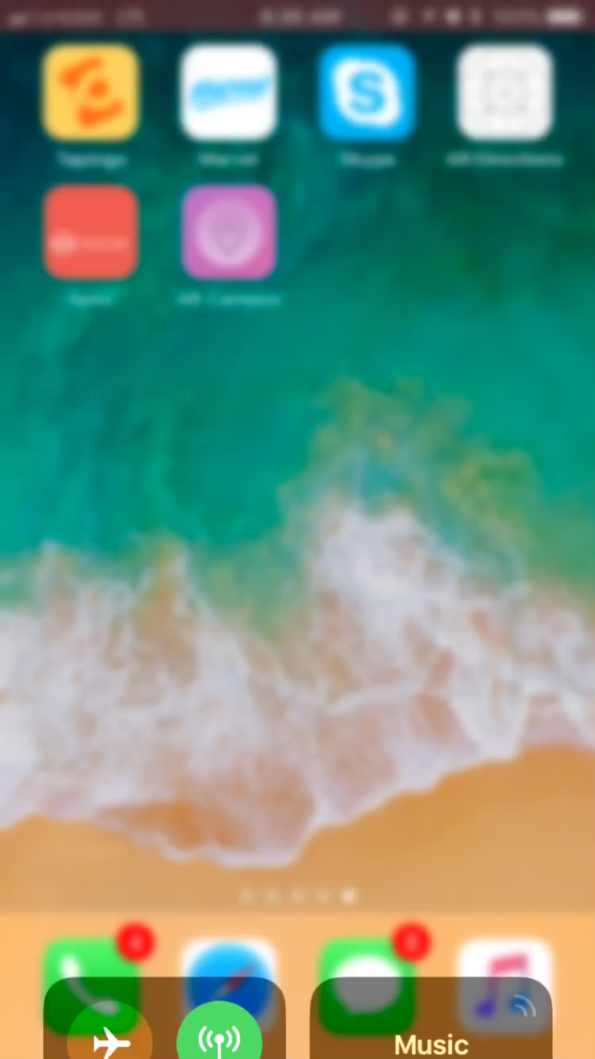

Landmark 5C
Explore and find your way around the world using Augmented Reality

